Slide 1
HCA Continuing Professional Development (CPD)
Lunch and Learn Toolkit

Slide 2
Contents
How to use this toolkit
Introduction to the HCA CPD Standards Framework
Frequently asked questions
Appendix 1: Lunch-and-learn slides
Appendix 2: Summary of HCA CPD standards report

Slide 3
How to use this toolkit

Slide 4
How to use this toolkit
Who is this toolkit for?
This toolkit has been developed to support organisations in providing their employees with information on the HCA CPD Standards Framework. It can be used by anyone in an organisation who supports employee career development programmes. This could include HR departments, Senior Management Teams or Leadership groups.
What is in the toolkit?
The toolkit provides background information about the HCA CPD Standards Framework, a template lunch-and-learn slide deck that can be used to inform your employees, and FAQ section that can be used to address any questions that you or your employees may have.
What will employees learn as a result of the lunch and learn?
We hope that employees will understand the benefits of embracing CPD and attaining annual HCA CPD Standards Certification, and learn how to enroll for certification and use CPD to support their career development.
How do I find our more?
The HCA would be happy to support organisations in engaging employees. If you have any further questions, please contact us at CPDStandards@the-hca.org.

Slide 5
Introduction to the HCA CPD Standards Framework

Slide 6
Why CPD standards are needed
The Healthcare Communications Association (HCA) has long been committed to supporting professional development, offering a range of courses and best-practice sharing sessions to help healthcare communication professionals to develop their knowledge and skills.
Until now, the healthcare sector has not had an agreed focus on the knowledge and skills areas to develop or the standard to which this should be achieved and maintained.
Establishing a CPD framework for healthcare communications gives our profession greater credibility as a serious discipline and helps to build confidence.
By strengthening credibility and building confidence within our sector, standards will help with the ongoing challenge of attracting and retaining talent from a diverse range of backgrounds; standards will also help to ensure equity for individuals by clarifying expectations.
A shared CPD framework will aid a common understanding across the different types of organisations (patient advocacy groups, pharmaceutical companies, communication agencies, etc.) and disciplines within healthcare communications.
Finally, by outlining the ongoing commitment needed, we will push ourselves to be constantly refreshing our knowledge and skills, thus ensuring the latest thinking and ongoing reinvigoration of best practice to help advance our sector.

Slide 7

HCA CPD Standards Framework
Based on insights from its members and research from across other professional bodies, the HCA have developed a CPD Standards Framework for healthcare communicators.
A report on the HCA CPD Standards Framework provides background and details on:
CPD in other sectors and organisations
Perspectives of HCA members on CPD
HCA recommendations on CPD
An HCA CPD roadmap for the future.
A summary of the report can be found in Appendix 1 of this toolkit and a free copy of Advancing healthcare communications: HCA CPD Standards can be downloaded here.

Slide 8
Frequently asked questions

Slide 9
Frequently asked questions
When does the programme start?
The HCA CPD Standards Framework was launched on 10 February 2022. However, an individual can decide when their annual CPD cycle begins.
Can anyone sign up to the CPD programme?
All healthcare communications professionals should continue their professional development. These standards guide on the minimal requirements an individual should aim for. Our certification scheme allows professionals to be recognised for achieving these standards annually.
Are HCA courses accredited?
All courses provided by the HCA are accredited through a three-stage process to ensure their quality. Further details can be found on www.the-hca.org
Do only HCA courses and events count?
The HCA offers many CPD-accredited courses across levels and disciplines. The HCA also provides members with extensive events and on demand content that would be valid for CPD. However, CPD points can be gained from any relevant learning, not just that provided by the HCA.
Can I achieve points from in-house training too?
CPD points can be gained from any relevant learning.
Can I collect points on courses I’ve attended already this year?
Any legitimate CPD undertaken in a 12-month cycle counts. Each individual decides when their annual cycle starts, and this can be historic.
How many points are associated with each course?
1 point = 1 hour of learning.
How many points do I need to get a year to gain/remain accredited?
See the summary available here.
How do I know how many points I have?
If you use the HCA’s free CPD Record platform it will automatically keep a record of your points.
Do I need a log in?
In order to record your CPD and submit for certification you will need to register at www.MyCPD.healthcare HCA members will login with their normal HCA website login.
What is the website address?
www.MyCPD.healthcare HCA members will find the CPD record platform can be accessed in the Members’ area of www.the-hca.org
How will my progress be monitored?
CPD is self-monitored, although your employer may have specific criteria they will monitor. Should you wish to be certified by the HCA for achieving the required annual standards then your application needs to be approved by your manager and, subsequently, the HCA. This is an automatic process built into the HCA’s CPD Record platform.
How do my CPD points link to my company development programme?
This will depend on each organisation’s approach. Please speak to your organisation’s HR team to find out more.
If you have any further questions, please contact us at CPDStandards@the-hca.org

Slide 10
Appendix one: Lunch-and-Learn slides

Slide 11
Developing your career with continuing professional development
[Name of organisation] in partnership with HCA
Lunch and Learn
[date]
[name of presenter]

Slide 12
Welcome
Introduction
What is the HCA CPD Standards Framework
A certified points system
Where should I focus my development?
Getting started
Sharing your experience
Questions

Slide 13
What is the HCA CPD Standards Framework?
A continuing professional development (CPD) programme for people working in healthcare communications
Designed by the industry, for the industry to advance skills, improve standards and build experience and confidence
A points-based system with the option for annual certification for achieving CPD standards
Applicable across the range of healthcare communication disciplines, roles and experience levels
Flexible to work alongside member organisation’s existing training progammes
Notes:
‘

Slide 14

A points-based system
Annual target of 32 CPD points*
≥ 6 points from Structured Learning
SUGGESTED ACTIVITIES FOR CPD:
Structured Learning
Courses
1-to-1 training or coaching
Online learning
Events
Researching, reading, writing and reviewing
Presenting
Committee or group work
Training, coaching or mentoring others
Volunteer/pro bono work in a related area
≥3 points from ethics and/or codes of practice
Points from HCA or non-HCA led activities
*1 CPD point = 1 hour learning/reflection

Slide 15
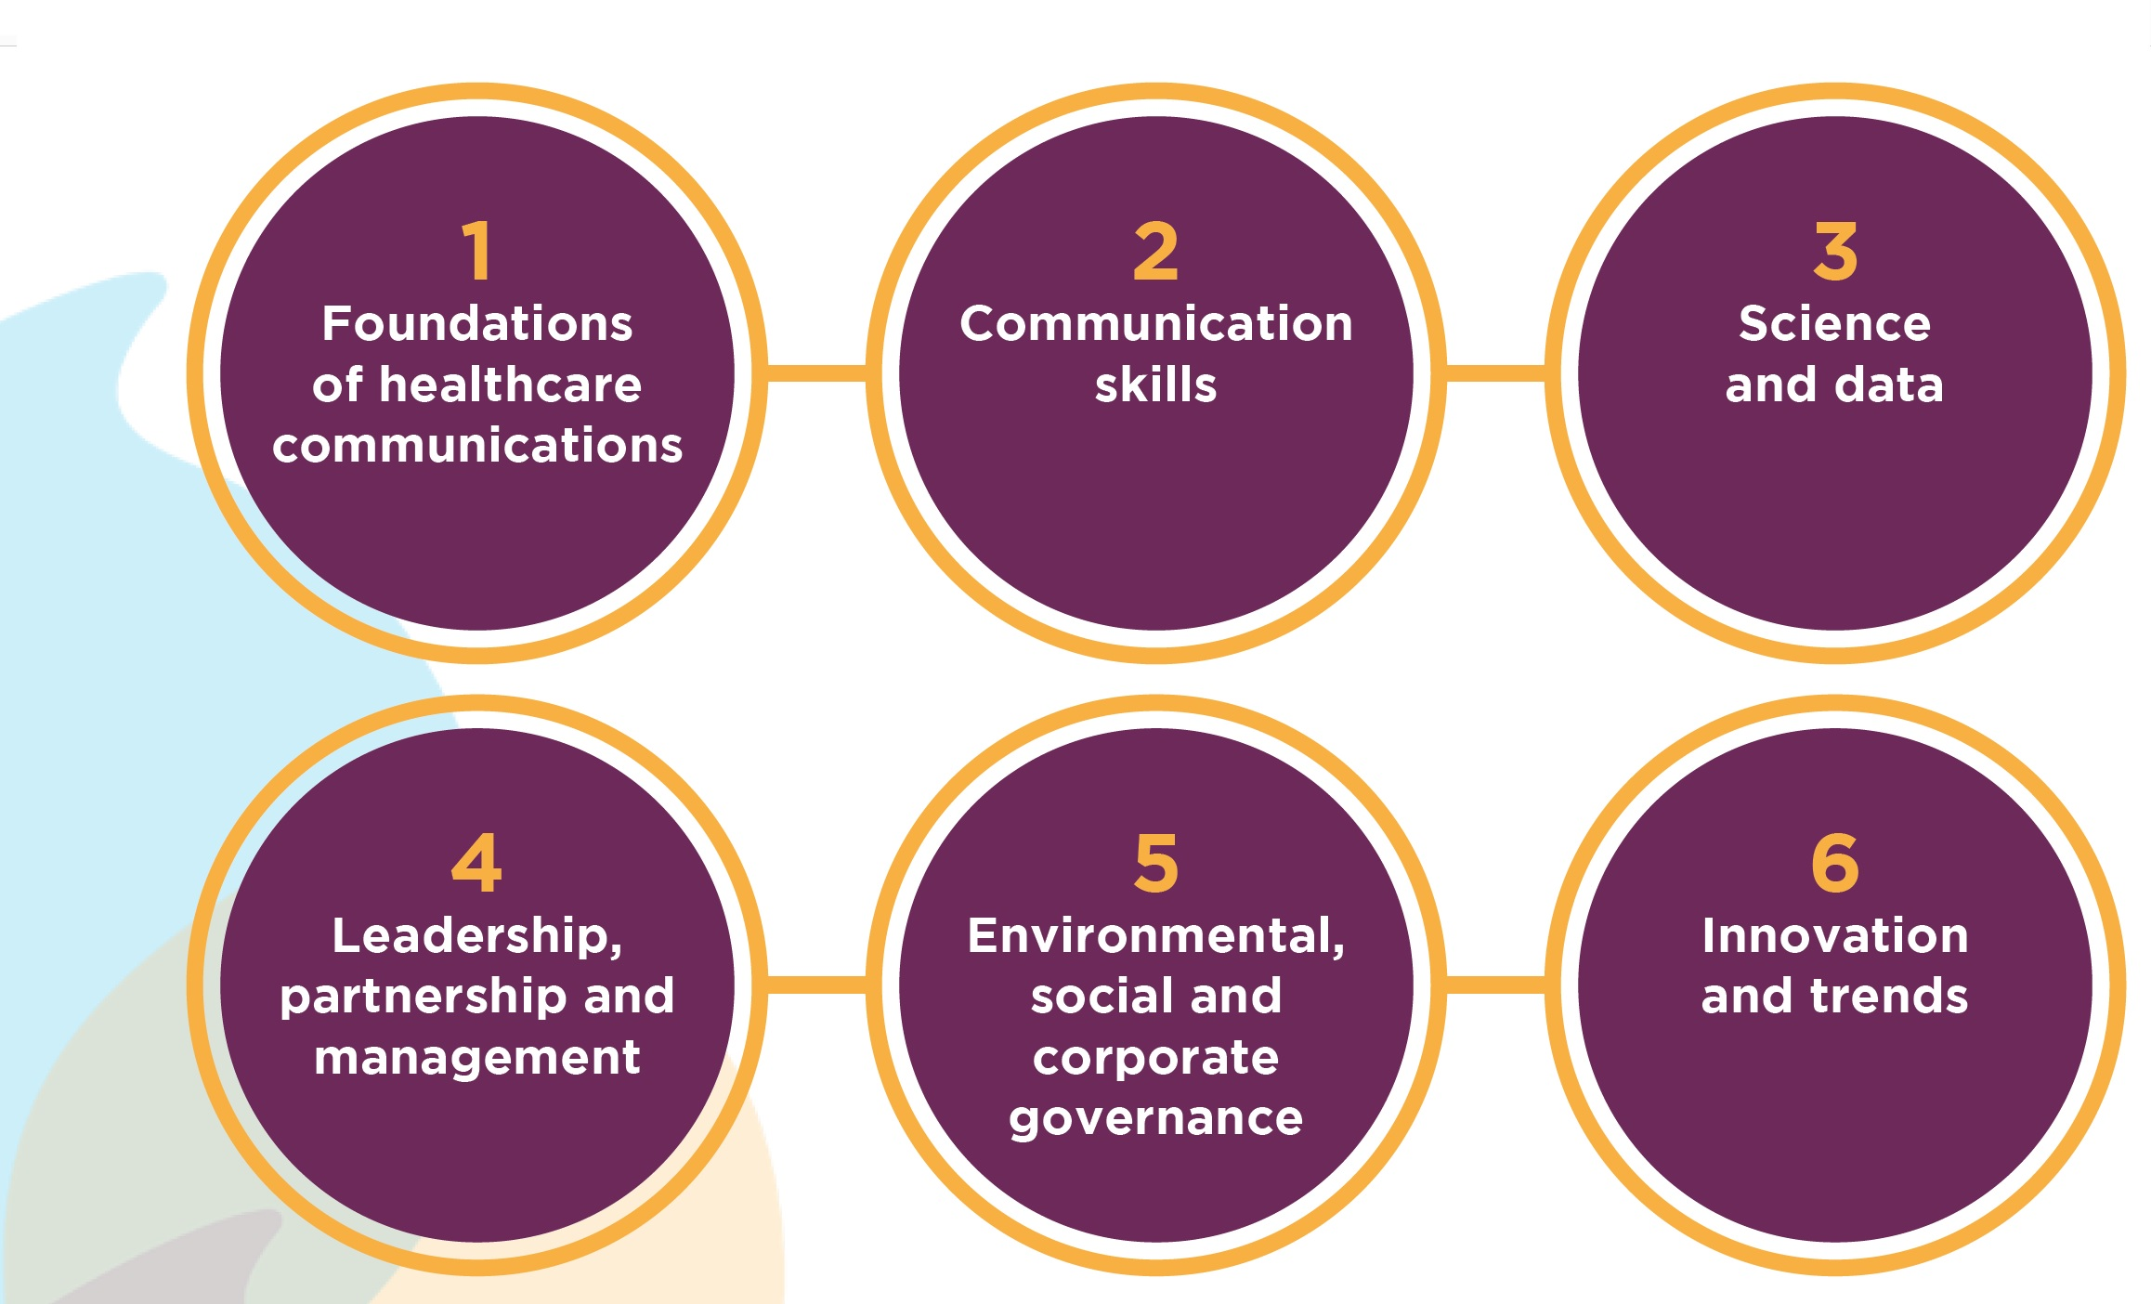
Where should I focus my development?
No matter what your discipline, role or level of experience, six competency spheres have been identified, each relevant for your professional development. However, which you focus on in your CPD, and the extent of knowledge and skills you should be aiming to build, will depend on your discipline, role and level

Slide 16
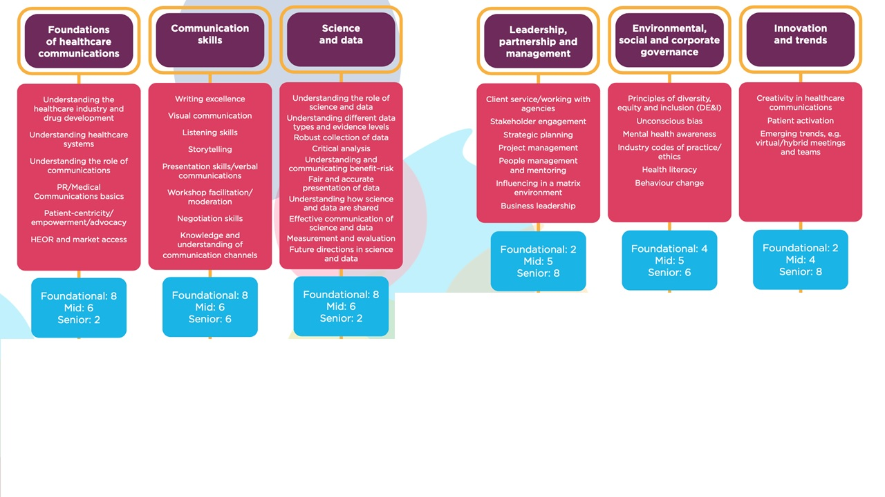
Example areas of focus by competency sphere
Guidance on annual CPD points per competency sphere by level of experience
Foundational equates to somebody in their first 3 years in healthcare communications,
mid-level to 4–8 years’ experience and senior to 9 years or more of experience in the industry
HEOR, health economic and outcomes research

Slide 17
How does this work alongside our [organisation] programme
The HCA CPD Standards Framework has been developed to support organisation’s existing training programmes
[Organisation to insert further detail]

Slide 18
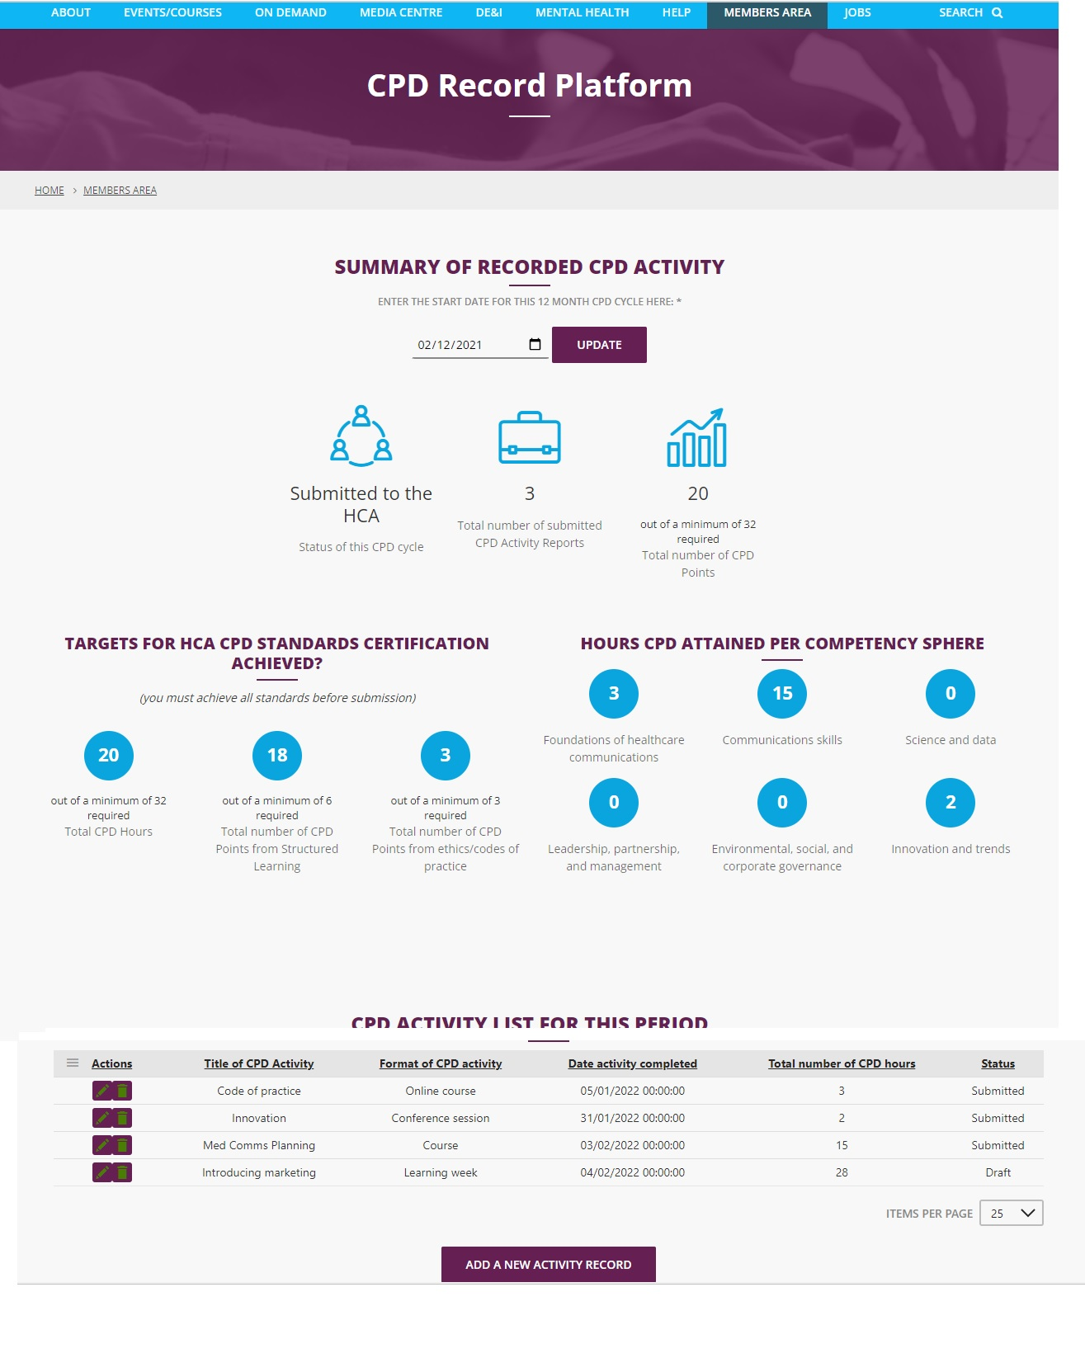

A platform for tracking CPD points
An online platform has been developed for you to use to record CPD activities and submit for annual certification www.MyCPD.healthcare
The platform is free to use
Available to members in their Members’ Area of website (MyCPD)
HCA CPD courses you attend will automatically be added to your record
At the end of a 12-month cycle, your manager will need to approve the record
Those reaching the required standards in a 12-month cycle will be eligible to display an HCA Certified to CPD Standards logo on their email signature, etc
Spot checks of submissions will be carried out by the HCA
\

Slide 19

Sharing your experience
The HCA is delighted to launch a CPD Standards Framework for our sector. We would value your thoughts and feedback, please share your experience with us at CPDStandards@the-hca.org
We would love it if you could help to ensure as many people as possible can benefit from the HCA CPD Standards Framework, by sharing your positive experiences and our ‘Year of CPD’ campaign digital assets with your networks. Please tag us at @Healthcare Communications Association (HCA) on LinkedIn or @the_hca on Twitter and use #MyCPDhealthcare

Slide 20
Thank you Any questions?

Slide 21
Appendix one: Summary of HCA CPD Standards Framework

Slide 22
Why a CPD framework is important for our sector
While the HCA offers a range of professional development opportunities, the knowledge/skills to focus on, the standards to be achieved and the ongoing commitment needed to maintain standards have not been agreed
Others provide CPD frameworks, but none focus on healthcare or cover the range of disciplines in our sector
A CPD framework would offer many benefits:
Greater credibility for our profession as a serious discipline; helps build confidence
Established standards, and the credibility and confidence they bring, should help attract and retaining talent
Standards also help ensure equity for individuals joining from a diverse range of backgrounds, by clarifying expectations
A framework aids common understanding across the different organisations and disciplines within healthcare communications
By outlining the ongoing commitment needed, we push ourselves to constantly refresh our knowledge and skills, thus ensuring the latest thinking and ongoing reinvigoration of best practice
A CPD framework will help advance our sector

Slide 23




The approach we took to developing a CPD framework
Common themes identified in our research:
Points-based systems
Generally based on 12-month cycle
With points gained from a range of sources and activities
The focus of the activities linked to a set of competencies
Best practice from professional bodies:
Led from the top but grown from the bottom
Delivered via an easy and accessible system
Our member views:
CPD is an area in which the HCA could support and add value
There is a need for a framework that is adaptable to support the array of disciplines, roles and levels encompassed by our sector
There is a need for the framework to complement existing professional development activities of HCA members
The CPD process must be simple, cost effective and efficient
Annual bench-marking survey
Desk research
1-to-1 interviews
Professional Development Standing Committee (includes representatives from pharmaceutical companies, agencies and PAG) drafted recommendations

Slide 24
A points-based system
Annual target of 32 CPD points*
≥ 6 points from Structured Learning
SUGGESTED ACTIVITIES FOR CPD:
Structured Learning
Courses
1-to-1 training or coaching
Online learning
Events
Researching, reading, writing and reviewing
Presenting
Committee or group work
Training, coaching or mentoring others
Volunteer/pro bono work in a related area
≥3 points from ethics and/or codes of practice
Points from HCA or non-HCA led activities
*1 CPD point = 1 hour learning/reflection

Slide 25
Six core competency spheres
Weighting of points per sphere will vary by level
Within a sphere, the focus can be tailored to discipline, role and level

Slide 26
Example areas of focus by competency sphere
Guidance on annual CPD points per competency sphere by level of experience
Foundational equates to somebody in their first 3 years in healthcare communications,
mid-level to 4–8 years’ experience and senior to 9 years or more of experience in the industry
HEOR, health economic and outcomes research

Slide 27
A platform for tracking CPD points
An online platform has been developed for you to use to record CPD activities and submit for annual certification www.MyCPD.healthcare
The platform is free to use
Available to members in their Members’ Area of website (MyCPD)
HCA CPD courses you attend will automatically be added to your record
At the end of a 12-month cycle, your manager will need to approve the record
Those reaching the required standards in a 12-month cycle will be eligible to display an HCA Certified to CPD Standards logo on their email signature, etc
Spot checks of submissions will be carried out by the HCA
\

